Slide 1
Methane Public Opinion Poll:
Policy Executive Report
Benchmark Wave: December 2023
Updated: April 2024

Slide 2
Table of Contents
3
Methodology & Research Interpretation
6
Research Results
21
Appendix

Slide 3
Methodology: Japan
BSG conducted a 10-minute online poll in Japan from between April 12 and April 16, 2024. We collected responses from n=752 Japanese adults.
The margin of error for the Japan wave is ±3.57%. Weights were applied to gender, race, and age to ensure the sample is reflective of Japanese adults ages 18+ who have access to the internet.
The survey fielded in Japan is identical to that fielded in Fall of 2023 (except for a Japan-specific policy question). However, because of the gap in time between our original wave and the Japan wave, Japan’s data is not reflected in regional or total study averages.
Japan’s internet penetration rate is 94%, indicating that our collected sample closely matches the makeup of Japan’s population.

Slide 4
Methodology: 17 Country Benchmark
Benenson Strategy Group conducted a 10-minute online poll in 17 countries between November 14th and December 11th, 2023.
In each country, we collected no less than n=750 responses from people currently residing in the country who are 18 years of age or older and who have internet access. The margin of error for the total sample of each country is approx. ±3.58%*. Weights were applied to age, gender, and education to ensure collected samples were representative of adults 18+ who have internet access in each country.
Research was conducted in the following countries:
Australia
Brazil
Canada
Chile
China
Germany
India
Italy
Kenya
Mexico
Nigeria
Norway
Senegal
South Korea
Tanzania
The United Kingdom
The United States
*Margin of error varies slightly between countries due to differences in sample size.

Slide 5
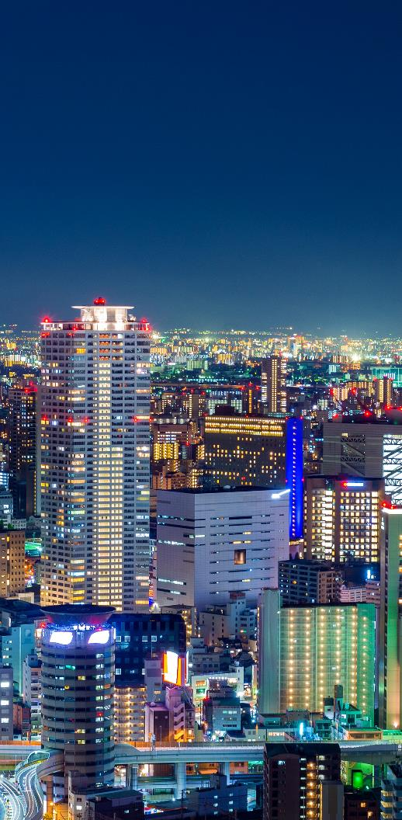
How to Interpret and Use Research Findings
This research is representative of adults 18+ who have access to the internet
Levels of internet access vary widely in the countries we surveyed
In countries with high internet penetration, our sample is closest to an accurate representation of the general adult population
In countries with lower internet penetration, our sample is higher income, more educated, and more likely to live in and around cities than the general population
Internet Penetration by Country (2020)*
Australia | 98% | United States | 92% | Mexico | 75%
United Kingdom | 97% | Canada | 89% | Nigeria | 64%
South Korea | 95% | Italy | 85% | India | 63%
Norway | 95% | Brazil | 77% | Kenya | 40%
Japan | 94% | Chile | 76% | Tanzania | 52%
Germany | 93% | China | 76% | Senegal | 28%
*Internet penetration data sourced from Statista and Internet World Stats

Slide 6
Research Results

Slide 7
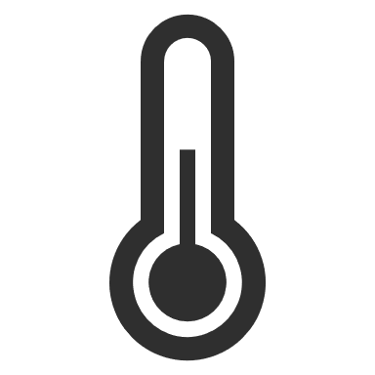
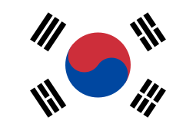
In the 18 countries that we conducted research in, most believe climate change is caused by humans, and feel its impact – but the intensity of this impact varies
In all 18 countries, a majority believe the climate is changing as a result of human activity
87%
agree climate change has at least some impact on their life
However, the level of belief varies significantly between countries:
91%
57%
In developing nations and the global south, the impact is generally perceived as strong or extreme…
South Korea is highest
Nigeria is lowest
…while in wealthier countries, respondents tended to be less personally concerned about the impacts of climate change
Very few people believe the climate is not changing, but a sizeable minority think climate change is not the result of human activity
*NOTE: Japan research conducted 4/12/24-4/16/24. Japan data is not reflected in total study or regional average data.

Slide 8
The strongest impact from climate change is felt in the Global South, while developed countries are more insulated from this impact, or feel it less intensely
Personal Impact from Climate Change
Extreme + Strong Impact
APAC
AFR
EUR
LATAM
NA
Extreme Impact
Q4.On a scale of 1-5, how much impact, if any, does the changing climate have on your life?
*NOTE: Japan research conducted 4/12/24-4/16/24. Japan data is not reflected in total study or regional average data.

Slide 9
A majority in all 18 countries prioritize protecting the environment over economic growth, but the margins reflect varied national priorities – with slightly more challenging local political environments for methane reform
Environment vs Economy
Countries in RED show less than 2 in 3 prioritize the environment
Protecting the environment should be prioritized over economic growth. | Economic growth should be prioritized over protecting the environment.
APAC
AFR
EUR
LATAM
NA
Q16. Which statement do you agree with more, even if you do not agree with either statement entirely?
*NOTE: Japan research conducted 4/12/24-4/16/24. Japan data is not reflected in total study or regional average data.

Slide 10
While methane familiarity is high across countries and regions, “informed familiarity” is much lower; across the 18 countries, there is little variation in understanding what methane is and where it comes from
Landfill gas, oil wells, and cow manure are perceived as the most common sources of methane emissions…
Methane familiarity is above 50% in all but two countries that we surveyed*
However, almost half of people (49% in the total study) who think they are familiar with methane don’t know that it is harmful for global climate
48%
Informed familiarity – being familiar with methane and able to identify methane as harmful for the global climate – is 37% across all 17 countries
55%
47%
37%
… and across countries, the most common methane associations are methane as a gas (40%) and methane as an energy source (29%)
*Methane familiarity in 41% in Japan and 34% in Senegal
*NOTE: Japan research conducted 4/12/24-4/16/24. Japan data is not reflected in total study or regional average data.

Slide 11
Total support for actions to minimize methane is high across countries, while intense support varies widely
Support for Action to Minimize Methane Emissions
Total Support
APAC
AFR
EUR
LATAM
NA
Strong Support
Q14. How much, if at all, do you support actions taken to minimize methane emissions?
*NOTE: Japan research conducted 4/12/24-4/16/24. Japan data is not reflected in total study or regional average data.

Slide 12
Less enthusiasm exists for policy change in the agriculture sector than for non-sector-specific methane action – this is particularly true in countries with agriculture-based economies
Support for Methane Action in Agriculture Sector Compared to General Methane Action
(Top Box “Strong Support” Difference in Percentage Points)
Countries in GREEN show differences above the margin of error
Q15. How much, if at all do you support actions to minimize methane emissions from each of the following sectors?
*NOTE: Japan research conducted 4/12/24-4/16/24. Japan data is not reflected in total study or regional average data.

Slide 13
Across the study, waste is the sector with the highest appetite for methane action – this is true in both developed and developing nations
Support for Methane Action in Waste Sector Compared to General Methane Action
(Top Box “Strong Support” Difference in Percentage Points)
Countries in PURPLE show differences above the margin of error
Q15. How much, if at all do you support actions to minimize methane emissions from each of the following sectors?
*NOTE: Japan research conducted 4/12/24-4/16/24. Japan data is not reflected in total study or regional average data.

Slide 14
A waste sector-specific methane reduction proposal is popular in every country where such policy was tested; intensity of support is lowest in developed nations
Support for Country-Specific Policies in the Waste Sector
Total Support
Strongly Support
The implementation of a policy that bans organic waste disposal into landfills and promotes source reduction, segregation, edible food rescue (food banking), composting, and other solutions that reduce food loss and waste through a circular approach.
The implementation of a policy that bans biodegradable waste disposal into landfills.
Q17. To what extent do you support or oppose the following in [COUNTRY]?
*NOTE: Japan research conducted 4/12/24-4/16/24. Japan data is not reflected in total study or regional average data.

Slide 15
Action in the energy sector, while not as popular as the waste sector, still has broad support across countries – China has particularly strong support compared to general methane action
Support for Methane Action in Energy Sector Compared to General Methane Action
(Top Box “Strong Support” Change in Percentage Points)
Countries in GOLD show
differences above the margin of error
Q14. How much, if at all, do you support actions taken to minimize methane emissions?
*NOTE: Japan research conducted 4/12/24-4/16/24. Japan data is not reflected in total study or regional average data.

Slide 16
Moderate to strong support for reform in the energy sector exists in nations where proposals were tested, with Italy showing the highest levels of support for energy policy proposals
Support for Country-Specific Policies in the Energy Sector
Total Support
Strongly Support
The implementation of a policy that requires other countries to minimize methane pollution and flaring when producing the oil and gas they export to South Korea.
The implementation of a policy that requires other countries to minimize methane pollution and flaring when producing the oil and gas they export to Japan.
European countries implementing policies that require other countries to minimize methane pollution and flaring when producing the oil and gas they export to Europe.
The implementation of a policy that requires other countries to minimize methane pollution and flaring when producing the oil and gas they export to [COUNTRY]…
Q17. To what extent do you support or oppose the following in [COUNTRY]?
*NOTE: Japan research conducted 4/12/24-4/16/24. Japan data is not reflected in total study or regional average data.

Slide 17
In Canada, the more “exciting” policy to regulate energy companies has stronger support than the policy “with teeth” to implement measurement requirements; in the US, framing regulation with “a fee to taxpayers” increases strong support for reform by 5pts
Support for Country-Specific Policies in the Energy Sector
Total Support
Strongly Support
The implementation of standards that require the oil and gas industry to find and fix wasteful methane leaks that contribute to pollution.
Improved methane emissions measurement data that the Government of Canada can use to ensure accountability.
The implementation of a policy that would require the oil and gas industry to pay a fee to taxpayers if they produce more methane pollution than the law allows.
The implementation of a fee that oil and gas producers must pay for wasted methane gas that contributes to pollution.
Q17. To what extent do you support or oppose the following in [COUNTRY]?

Slide 18
In non-sector-specific policy proposals, we see a continued trend of stronger support in the Global South, with less intensity of support for policy reform in developed nations
Support for Country-Specific Methane Reduction Policies
Total Support
Strongly Support
Increasing the penalty that the Norwegian Government charges companies for every cubic meter of methane gas vented to deter methane venting.
The implementation of new federal policies to reduce flaring and methane pollution.
The implementation of regulations to minimize wasteful methane pollution.
The implementation of new federal policies to reduce flaring and methane pollution.
The implementation of national methane reduction targets by 2025.
Q17. To what extent do you support or oppose the following in [COUNTRY]?

Slide 19
In China, technical barriers and insufficient subsidies are seen as leading challenges to methane recycling efforts; the Chinese public sees both the state and private sector as playing a role in decommissioning abandoned coal mines
% Identifying Challenge:
In your view, what challenges exist, if any, for the national incentive measures for the recycling and utilization of low-concentration methane?
When it comes to decommissioning coal mines and transferring mining rights from enterprises to the state, who do you think should bear the governance costs of abandoned mines?
Q18. In your view, what challenges exist, if any, for the national incentive measures for the recycling and utilization of low-concentration methane? Q19. When it comes to decommissioning coal mines and transferring mining rights from enterprises to the state, who do you think should bear the governance costs of abandoned mines?

Slide 20
Large corporations and national governments are seen as both most to blame and most capable of action on climate; news outlets and scientists are top climate change information sources in every country
Large corporations, national governments, and individual citizens are the most to blame for environmental harm…
Top Climate Change Information Sources
Local news outlets
International news outlets
Local scientists
International scientists
1
2
3
Perceived blame:
Only…
19%
28%
Large Corporations
National Governments
Individual
Citizens
…but most believe that individual citizens are not capable of creating meaningful change to minimize the impacts of climate change
1
2
3
…get their information about climate change from celebrities or politicians
Perceived capability:
51%
see international government systems as very capable
44%
see international NGOs as very capable
National Governments
Large Corporations
International Government Systems
Q20/Q21 stakeholder options for blame and capability : 1) individual citizens, 2) small businesses/local farmers, 3) large corporations, 4) financial institutions, 5) local/state/regional governments, 6) national governments, 7) international government systems, 8) international non-government organizations.
*NOTE: Japan research conducted 4/12/24-4/16/24. Japan data is not reflected in total study or regional average data.

Slide 21
Appendix

Slide 22
Belief in anthropogenic global warming (AGW) varies widely across countries, but never dips below 50%; except for Nigeria, the Global South has higher levels of AGW belief
Climate Change Belief
The climate is changing as a result of human actions | The climate is changing, but not from human actions + The climate is not changing
APAC
AFR
EUR
LATAM
NA
Q3. Which of the following comes closest to your view on climate change, even if none fits your view exactly
*NOTE: Japan research conducted 4/12/24-4/16/24. Japan data is not reflected in total study or regional average data.

Slide 23
Likewise, the Global South has the highest support for climate change action – particularly in the West, support for climate action is polarized by political party
Total Support
Support for Action to Minimize Climate Change
APAC
AFR
EUR
LATAM
NA
Strong Support
Q5. How much, if at all, do you support actions taken to minimize the impacts of climate change?
*NOTE: Japan research conducted 4/12/24-4/16/24. Japan data is not reflected in total study or regional average data.

Slide 24
In countries where the government is seen as less capable – particularly nations in the Global South – the public views environmental protection as primarily a responsibility of individual citizens
Responsibility for Environmental Protection
Individual Citizens | Private Sector | Government
APAC
AFR
EUR
LATAM
NA
Q6. From the list below, which of the following is most responsible for protecting the environment?
*NOTE: Japan research conducted 4/12/24-4/16/24. Japan data is not reflected in total study or regional average data.

Slide 25
Lack of informed familiarity about methane is currently a barrier to growing support for reform: many who are “familiar” with methane aren’t aware of its negative climate impact
Those who say they are familiar with methane
Methane Familiarity
Total Familiar:
APAC
AFR
EUR
LATAM
NA
“Informed” Familiar:
Those who are familiar with methane AND correctly identify methane as having a negative impact on the global climate
Q9.How familiar are you, if at all, with methane? Q12. What type of impact, if any, do you think methane has on the global climate?
*NOTE: Japan research conducted 4/12/24-4/16/24. Japan data is not reflected in total study or regional average data.

Slide 26
This study is representative of the 18 countries we conducted research in – it is NOT representative of all countries
This data is an international study, representative of public opinion among the adult populations with internet access in 17 countries |  | This data is not a global study; it is not meant to be representative of public opinion in all nations
When “total study” figures are referenced, they are representative of the 17 countries surveyed, weighted for population size* |  | “Total study” figures are NOT representative of the entire world
When “regional” figures are referenced, they are representative of the countries we surveyed in that region, weighted for population size* |  | “Regional figures” are NOT representative of the entire region/continent
Example: LATAM methane support = 86%
X 86% of all Latin Americans support minimizing methane. X
✔In Brazil and Chile, approx. 86% of adults with access to the internet strongly or somewhat support actions to minimize methane emissions. ✔
NOTE: Japan data is not reflected in total study or regional averages
TOTAL STUDY ≠ GLOBAL
*NOTE: Japan research conducted 4/12/24-4/16/24. Japan data is not reflected in total study or regional average data.

Slide 27
Thank You
PROJECT TEAM
Natalie Lupiani
Vice President
nlupiani@bsgco.com
Shannon Currie
Vice President
scurrie@bsgco.com
Liz Dunne
Of Counsel
ldunne@bsgco.com
Mike Kulisheck
SVP of Research
mkulisheck@bsgco.com
Sarah Stellick Seepaulsingh
Associate
ssseepaulsingh@bsgco.com
Jacob Coughlin
Senior Analyst
jcoughlin@bsgco.com

